Slide 1



Crowdsourcing Metadata
Reliably Augmenting Documents By Collecting and Interpreting Amateur Contributions
Peter Organisciak
September 22, 2015
1
Notes:
Good morning.
Thank you for coming.
Particularly, I’d like to thanks my committee: Mike, Miles, Jaime, and Stephen for their time.

Slide 2


Maximizing data quality
in using paid crowds for objective and
subjective encoding tasks
Notes:
Today, I’m presenting my dissertation research pertaining to data quality issues in crowdsourcing.
How do you interpret and collect contributions from paid online crowds reliably?
Before I delve too deep into what exactly that means, it’s important to understand some of the background around what is known as crowdsourcing and how it pertains to us.

Slide 3
INTRODUCTION
Crowdsourcing

Citizen Science


Commons-Based Peer Production

Human Computation
Free/Open Source
Human work organized in the manner and tropes of computation
Creation from the commons, stemming from increased agency in networked information economy.
Crowdsourcing
A principle of software source code openness that evolved into a model of hyper-collaboration, often without discrimination toward the contributor, and quick user-focused development.
Broadly describes the use of distributed crowds to complete a task that would otherwise be done by one or a few people.
Captures the ability of the Internet toefficiently connect people


User Innovation
Wisdom of the Crowds
Shifting focus on creation by a product’s users.
observes the collected effectiveness of crowds when properly aggregated
von Hippel 1988
Raymond 1999
von Ahn 2004
Surowiecki 2004
Benkler 2006
Howe 2006
3
Notes:
Crowdsourcing refers to the action of outsourcing a task that might traditionally be done by a single person to a large, often self-selected group of people.
It was coined in an article of Wired in 2006. However, the idea of many amateurs collaborating directly or indirectly on the same product is not new, and different facets of crowdsourcing were previously studied.
<slide>
In 2006, Yokai Benkler wrote Wealth of Networks, a critical work trying to understand networked information society. There, he noted the ability of the Internet to empower people to create information goods for each other in the commons, rather than receiving them from firms.
Eric von Hippel has been making a similar argument for decades, around technology’s recontextualization on users.
In 2004, pop science book Wisdom of the Crowds popularized interest in the collective intelligences of crowds, when they are well connected.
That same year, the concept of Human Computation was beginning to gain traction. If the wisdom of the crowds refers to the unique abilities of human intelligence in aggregate, human computation focuses on human abilities as distinct from computational methods -- for so long as they are distinct -- and aims to formalize methods to organize humans in manners akin to automation.
Of course, the vanguard of how well people can collaborate through the aid of networked technology is the free software movement, with started by sharing source code for software but experienced a sea change with the hyper-collaborative Linux project in the early 90s.
Amateur and hobbyist collaboration dates back earlier than that.

Slide 4
INTRODUCTION
Information Science
Image Tagging
Content Recommendation
Describing images in different language.
e.g. steve.museum, The Commons
Judging information quality, reviewing/filtering, user-curated lists.
e.g. Bibliocommons


Relevance Judgments (IR Evaluation)

Generate custom evaluation datasets over novel corpora.


−
Transcription
e.g. Transcribe Bentham, Trove, What’s on the Menu
Research
Other Encoding
Galaxy Zoo, Snapshot Serengeti
4

Slide 5
INTRODUCTION
Types of Crowdsourcing
Paid
Creative
Volunteer
Reactive
Reactions to existing information objects
Subjective
A ‘good’ contribution depends on context
Objective
Working toward a universal or agreeable ‘truth’
5
 More in chapter: Design Facets of Crowdsourcing: A Typology for Information Science

Slide 6
INTRODUCTION
Why does this matter?
Digitized and born-digital information is outpacing our ability to clean, annotate, organize it. Crowdsourcing is being used to address these problems
In information retrieval,
Custom evaluation datasets (research over novel datasets!) – e.g. Alonso 2008
Understanding unseen queries (e.g. Chen and Jain 2013)
Adding additional metadata to documents implicitly (e.g. Lamere 2008) or on-demand (e.g. Finin et al 2010)
6

Slide 7
INTRODUCTION
Why does this matter?
Crowdsourcing is the path toward qualitative big data
… but we need to understand it.
7

Slide 8

❑
Humans have predictable and unpredictable biases that make it difficult to systematically adopt their contributions in an information system.
Notes:
And this brings me to my problem. Crowds are great because they’re perceptive, clever, and dynamic. This makes them good at things algorithms aren’t good at. But that also contributes to predictable and unpredictable biases.

Slide 9
Changing the incentive structure can change contributions (Mason and Watts 2010)

Slide 10

Maximizing data quality
in using paid crowds for objective and
subjective encoding tasks
Notes:
So, let’s return now to the goal I stated at the start: maximizing data quality.
How do you get good, reliable contributions?
There are a number of places to focus on. For this study I looked at three.

Slide 11
INTRODUCTION
Typical Task



11

Slide 12
INTRODUCTION
This study’s focus









12

Slide 13
INTRODUCTION
Research Questions
Broad Research Question #1
Broad Research Question #2
Broad Research Question #3



What are the post-collection indicators of quality in worker-contributed objective task data, and can these be leveraged for improved data modelling?
What are the biases inherent to the task design for objective or normative tasks (i.e. the data collection instrument), and can design manipulations correct for them at collection time?
What are the quality losses when treating non-normative tasks in objective ways, and can collection-time framing or post-collection modeling approaches reduce these?
13

Slide 14
INTRODUCTION
Scope
Paid
Creative
Volunteer
Reactive
Reactions to existing information objects
Subjective
A ‘good’ contribution depends on context
Objective
Working toward a universal or agreeable ‘truth’
14

Slide 15
Interpreting Objective Tasks For Paid Crowdsourcing
Broad Research Question #1
Broad Research Question #2
Broad Research Question #3



What are the post-collection indicators of quality in worker-contributed objective task data, and can these be leveraged for improved data modelling?
What are the biases inherent to the task design for objective or normative tasks (i.e. the data collection instrument), and can design manipulations correct for them at collection time?
What are the quality losses when treating non-normative tasks in objective ways, and can collection-time framing or post-collection modeling approaches reduce these?
Work completed with Miles Efron, Katrina Fenlon, and Megan Senseney
15

Slide 16
How can you determine if a contribution by a self-selected amateur is reliable?

Slide 17
INTERPRETING OBJECTIVE TASKS FOR PAID CROWDSOURCING
Questions
Experience
Do raters grow more reliable over time?
Can you account for the rating distribution given the rater's experience?
Agreement
Does a rater's agreement or disagreement with other raters reflect their overall quality as a rater? We also investigated ways to quantify disagreement and to correct for it.
Temporality
Does the length of time that a rater spends on a question reflect the quality of their rating?
17

Slide 18
INTERPRETING OBJECTIVE TASKS FOR PAID CROWDSOURCING
Data
Primary Dataset: IR Relevance Judgments


Comparison Dataset: Twitter Sentiment Judgments
23000 relevance judgments produced by self-selected, semi-anonymous workers.
Collected through paid platform Amazon Mechanical Turk, judging retrieval over variable length documents in cultural heritage collection.
Sentiment ratings for a series of tweets also generated on Mechanical Turk.

5 contribution options
Granularity

3 contribution options
Granularity
18
Notes:
- With Information retrieval relevance judgments, you export a series of possible results for a query, then people judge how strong those results are.

Slide 19
INTERPRETING OBJECTIVE TASKS FOR PAID CROWDSOURCING
Findings: What can we learn about contribution quality after collection?
Mechanical Turk raters are generally honest
Raters grow comfortable with a task quickly, and their quality does not significantly increase with more experience
Iterative (EM-like) algorithms remove more problem raters with complex tasks. The improvement for relevance judgments is small
For clean, simple task, majority voting among multiple raters is enough
Raters that get the first rating of a task correct are better raters overall

19
Notes:
- which is to say, they tend toward correct answers

Slide 20
INTERPRETING OBJECTIVE TASKS FOR PAID CROWDSOURCING
Findings: Temporality
Does the amount of time a user spends answering each task help us understand their quality as a rater?
No, except for the first task.
P=0.064
P=0.154 when excluding extreme outliers
Wilcoxon Rank Sum
20

Slide 21
A+
A
B
C
D
Density of percentage of accurate ratings after the first in a set, dependent on whether the first rating was correct. Higher density toward the right side of the graph indicates better performance. When raters started a set incorrectly, their performance skewed much lower for the rest of the set.

Slide 22
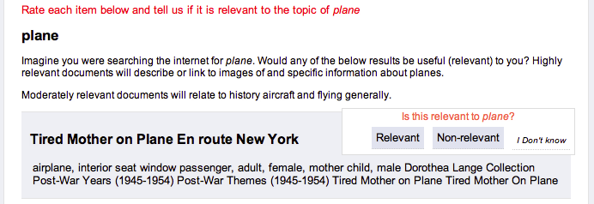
INTERPRETING OBJECTIVE TASKS FOR PAID CROWDSOURCING
People like to interpret
Better contributions come from people that spend more time reading instructions
22

Slide 23
How do you control for different interpretations of a task?
Scaling up difficulty
Normalizing for user-specific biases
Training, testing
Feedback
Anchoring

Slide 24
Designing Tasks for Objective Needs
Broad Research Question #1
Broad Research Question #2
Broad Research Question #3



What are the post-collection indicators of quality in worker-contributed objective task data, and can these be leveraged for improved data modelling?
What are the biases inherent to the task design for objective or normative tasks (i.e. the data collection instrument), and can design manipulations correct for them at collection time?
What are the quality losses when treating non-normative tasks in objective ways, and can collection-time framing or post-collection modeling approaches reduce these?
24
Notes:
\newthought{If we consider crowdsourcing data quality} as something that can be addressed not only through post-collection modeling but through the choices made in designing the collection task, the latter approach is surely the lesser studied problem. However, in cost-time considerations, design promises more efficient improvements. A design that is more interesting to workers or less prone to error may result in better contributions at no extra cost, while designs that offer bonuses or training include short-term costs. For example, @mason_financial_2010 found that a small change in instrumentation -- changing remuneration to less tightly govern the task -- resulted in more work contributed with happier contributors.

Slide 25
Evidence suggests that the design of a data collection interface affects the quality and distribution of user contributions [@alonso_crowdsourcing_2008; @howe_crowdsourcing_2008; @mason_financial_2010; @mitra_comparing_2015].

Slide 26
A comparison of data collected by different interfaces with a controlled task.

Slide 27
DESIGNING TASKS FOR OBJECTIVE NEEDS
Two Task Domains


Relevance Judgments over Image Retrieval
Image Tagging
30 results each for 13 queries against a corpus of 185.6k images
Evaluation
12037 judgments collections
Tags for 100 images randomly sampled from 185k document corpus
Evaluation
6201 tags collected (just under 2000 unique tags)
27

Slide 28
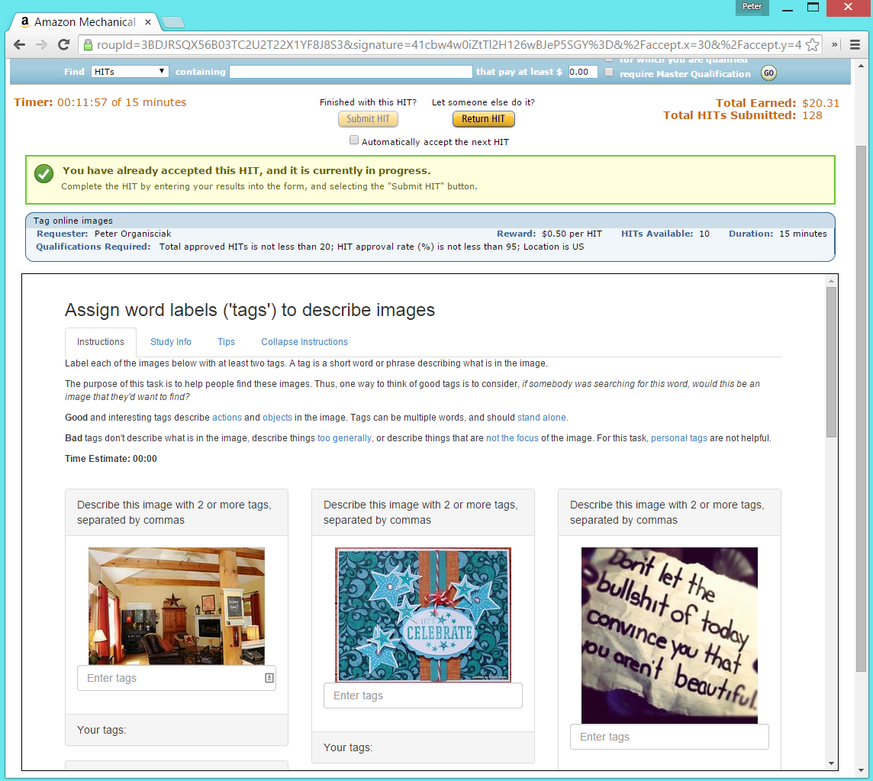
BASIC

Slide 29
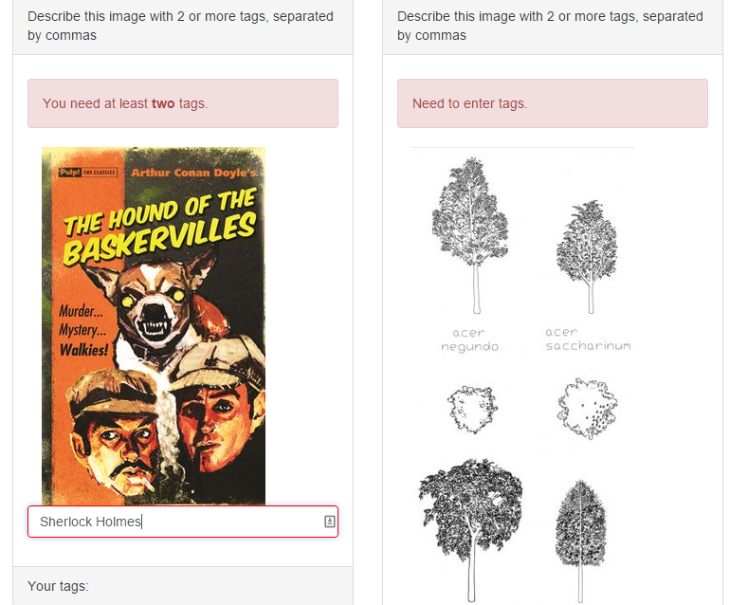
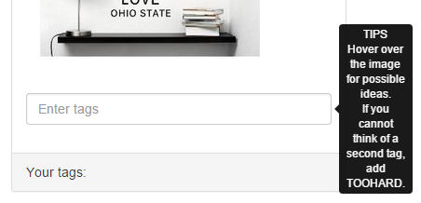

Slide 30
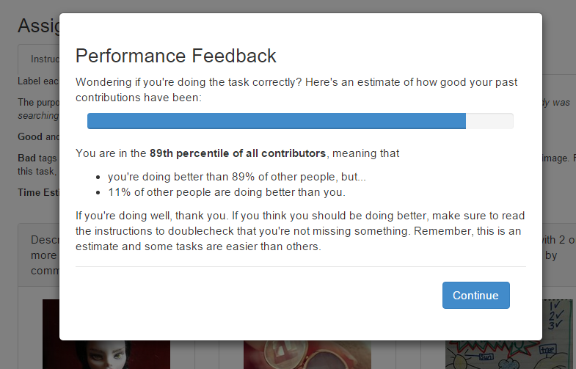
FEEDBACK

Slide 31
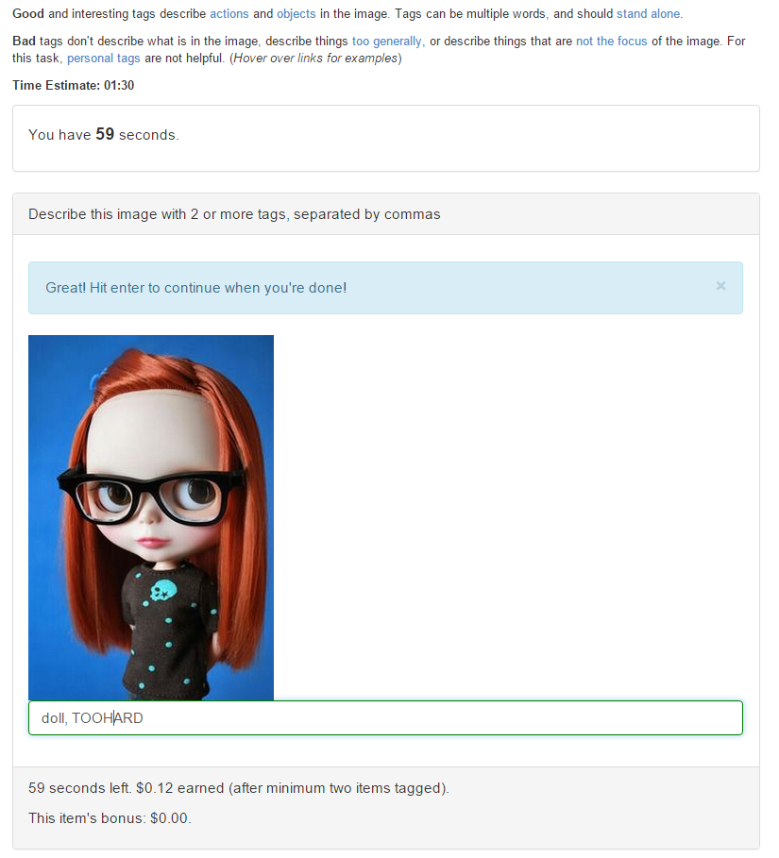
FAST

Slide 32
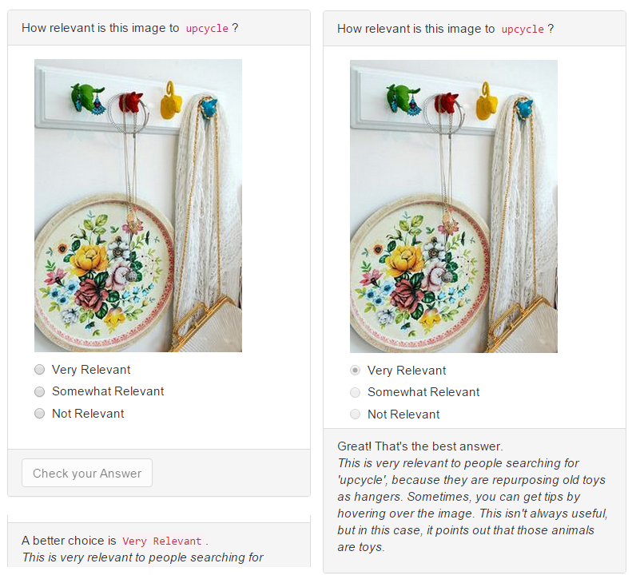
TRAIN

Slide 33
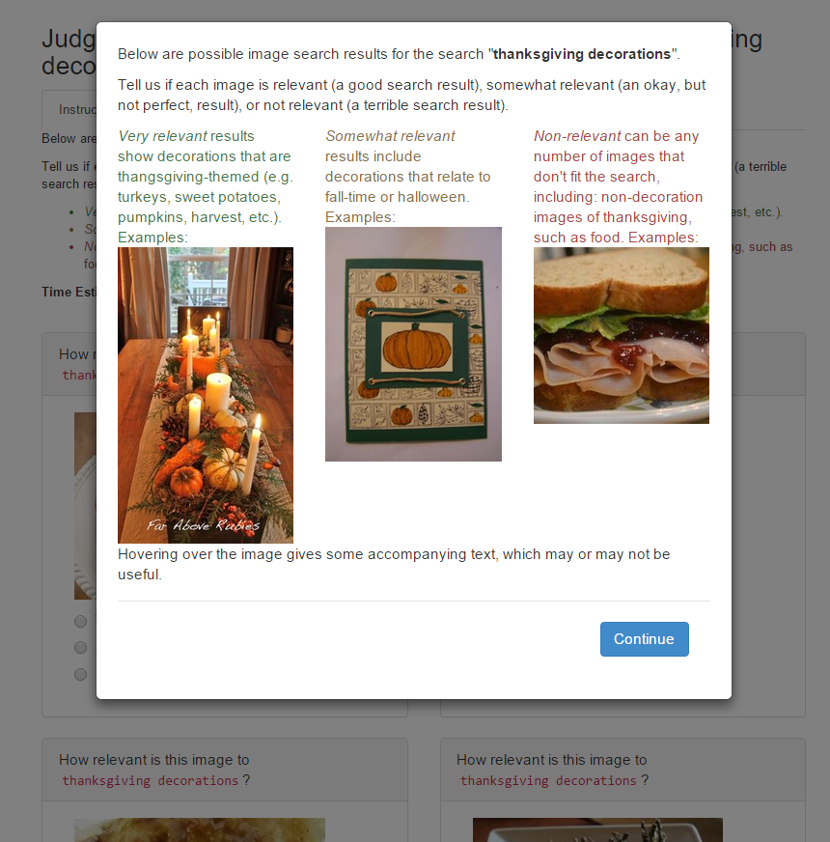
INSTRUCT

Slide 34
DESIGNING TASKS FOR OBJECTIVE NEEDS
Results
Per-Task Training Intervention (INSTRUCT)
highly significantly improved the quality of results
 No Change
Performance Feedback Interface (FDBK)
significantly improved the quality of results
  
First-Task Training Intervention (TRAIN)
Did not significantly change performance
   
Time-limited Interface (FAST)
significantly lowered the quality of results
   

Relevance Judgments over Image Retrieval
condition | mean | median | std.dev | sig
BASE | 0.734 | 0.800 | 0.269 | /
FAST | 0.693 | 0.800 | 0.267 | **
FDBK | 0.796 | 0.875 | 0.216 | *
INSTRUCT | 0.791 | 0.857 | 0.259 | **
TRAIN | 0.780 | 0.800 | 0.214
34
Notes:
The best work was contributed by workers in the training intervention (INSTRUCT) condition. Their contributions were significantly more accurate at the same cost and with no discernible change in time per task. However, supporting the interpreted finding in the previous chapter, accompanying the improved performance was more time spend reading instructions. In the previous chapter this measurement was confounded with the completion of the first task, here we confirm it.
INSTRUCT is an easy condition to parameterize, only requiring a one-time cost from the requester to collect training examples and perhaps a slight development cost to implement instructions as a dismissable, up-front modal window.
The intervention in INSTRUCT was in part motivated by Shu et al. (2012), who found that for reporting forms requiring a signature to confirm honesty, such as tax or insurance forms, asking people to sign at the top led to more honest reporting. By foregrounding the instructions, this condition seems to encourage workers to be more honest about the codebook. An unknown caveat is whether this is a persistent effect or, if after enough tasks with this condition, workers start to dismiss the information sooner. With the rotating workforce on Mechanical Turk, this would not be a concern for contexts similar to this study, but would be worth studying if applied in alternate contexts.
also improves on the baseline condition. Like with INSTRUCT, three-quarters of query-document pairs were corrected classified by two-thirds of contributors. This means that with as few as three redundant judgments, most of the consensus votes would be correct.
A surprise with the feedback task was that workers did not slow down, but indeed performed the tasks quicker. The reason for this behavior is unclear. Figure 19 shows the correlation between time spent the ranked percentile that the worker was given, which does not show any clear linear pattern.
One possible explanation is that, while workers in the 60th percentile slowed down to try to improve, the best workers were validated to trust their instincts while the worst workers did not care. The goal of the performance feedback was to give honest but poorly performing workers an indicator of lower quality contributions. This somewhat performed its function in the middle of the pack, but didn’t compel the poorest workers.
, TRAIN, was not significantly different in quality from the baseline, which appears to confirm that training on one query does not assist in completing relevance judgments for other queries.
Notably, TRAIN slowed down workers, as if the close training with one query made then sensitive to nuances that other queries may have. This did not translate to performance improvements, however.
did not perform as strongly as expected. However, the accompanying expectation was not seen in the data: that for the loss in quality, FAST would increase the speed on contributions and potential improve the capacity to collect redundant judgments.
To the contrary, FAST was not fast. A possible explanation is that image relevance judgments are already a very quick interaction, only a few seconds. The one-at-a-time fast interface may have stood in the way of workers’ comprehension of the entire task set: where in a traditional setting they can click on their answer and already be thinking about the next one, here they had to click again to move to the next task. It is possible that for relevance judgments over more complex types of documents, the fast interface would perform differently, akin to what will be seen in the next experiment.
Figure 20. Likelihood of correct relevance judgment shown by query
(Figure 20) offers some insight as to the relative strengths and weaknesses of the various conditions.
The thirteen queries tested are shown as columns in Figure 20. Despite across-the-board worse results, the places where FAST appears to stumble most is where there was nuance to the instructions, in edge cases where one might consult the instructions again. For example, are other tattoos relevant to rose tattoo? (No.) Are other flowers relevant? (Somewhat.) The instructions for what was very relevant, somewhat relevant, or not relevant were in a way subjective, in that they were interpreted by myself when written, but this simply grounded the correct answer in a single interpretation.
The query analysis also shows places where the hand-chosen examples for INSTRUCT seemed to mislead. ‘agape’, a Christian word relating to love, was extremely underrepresented in our sample, and all the results were non-relevant. This was a tricky inclusion, and by showing workers in INSTRUCT examples of relevant or somewhat relevant, it may have additionally misled workers to expect that there are relevant results. Likewise, it seems that the manual choice of examples for ‘Islam’ and ‘Easter crafts’ also misled to a certain extent.

Slide 35
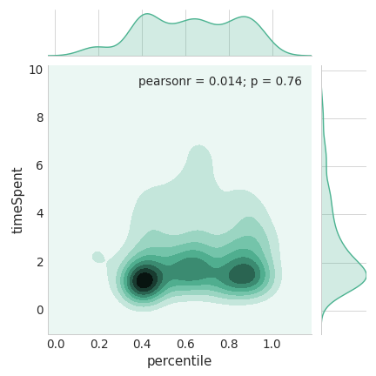

Slide 36
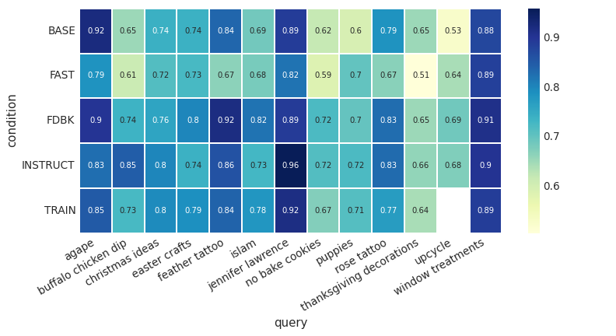

Slide 37
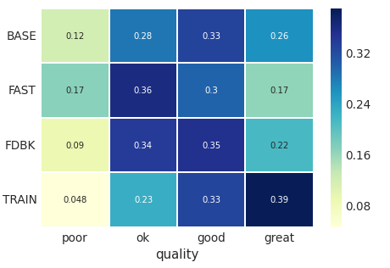
DESIGNING TASKS FOR OBJECTIVE NEEDS
Results
First-Task Training Intervention (TRAIN)
highly significantly improved the quality of results
    
Performance Feedback Interface (FDBK)
Did not significantly change performance
    
Time-limited Interface (FAST)
significantly lowered the quality of results
   

Image Tagging
condition | mean | median | std
BASE | 2.739 | 2.738 | 0.353
FAST | 2.457 | 2.420 | 0.355
FDBK | 2.648 | 2.667 | 0.580
TRAIN | 3.071 | 3.000 | 0.591
37
Notes:
The training condition was very appropriate for this type of task, clearly improving on the quality of tags received as well as worker satisfaction. These finding are promising because the implemented approach to training only requires extra effort in designing the training task set, and extra costs for the one task set, per worker, where they are not contributing new information on unknown images. However, beyond this, there are no ongoing costs. An alternative to implementing the training set as its own task set is implementing it as a ‘Qualification Test’ rather than a paid task – a function of Mechanical Turk (and similarly implemented on other platforms) that allows a test to be used in order to assign a custom qualification, against which task sets can be restricted.
The disproportionally high satisfaction scores for TRAIN are notable, because they lend insight on worker needs. Note that the measurement of TRAIN is through the post-training task sets, which are identical to the baseline. The only different is the priming task that preceded them. In context, it seems that workers prefer the close guidance, to confirm for them how the task should be completed.
Unlike the relevance judgment task type, performance feedback was inefficient for tagging. While the satisfaction response rates were low for this condition, they did not indicate any discontent with the task.
Instead, it is likely that this is not a task where unguided feedback is the intervention that is necessary. By design, the feedback condition does not tell a worker the reasons for their rank, instead trying to coax them to read the instructions closer if they are unsatisfied with their rank. However, the tagging task was less structured, and workers might need inspiration more than feedback. It would be interesting to conduct the feedback task in concert with training.
The FAST condition resulted in contributions received twice as quickly, though at a quality loss. Recalling Figure (???) and the relationship between good tags and length, the types of tags contributed by the time-limited condition skewed toward the short end (Table 10).
Table 10. Mean tag character and word length of tags in each condition.
condition
Mean Length
Median Length
Mean Word Count
Median Word Count
BASE
10.223
8
1.682
1
FAST
9.014
7
1.524
1
FDBK
7.798
7
1.260
1
TRAIN
13.596
13
2.143
2
In a circumstance where shorter tags are useful, the time-limited condition might be preferable for its ability to collect contributions twice as fast.

Slide 38
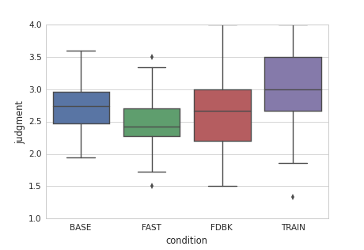
Figure 23. Distribution of each item’s average tag quality.

Slide 41
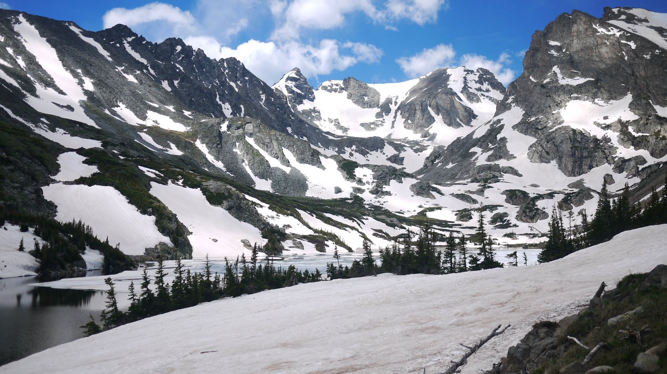
❑
Not all crowdsourcing uses have a common goal or objective. There are many needs that differ from person to person.

Slide 42
Broad Research Question #1
Broad Research Question #2
Broad Research Question #3



What are the post-collection indicators of quality in worker-contributed objective task data, and can these be leveraged for improved data modelling?
What are the biases inherent to the task design for objective or normative tasks (i.e. the data collection instrument), and can design manipulations correct for them at collection time?
What are the quality losses when treating non-normative tasks in objective ways, and can collection-time framing or post-collection modeling approaches reduce these?
42

Slide 43
DESIGNING TASKS FOR SUBJECTIVE NEEDS
Personalized Crowdsourcing is good for…


Personal collections
E.g. personal photos, email


New corpora

E.g. the next Amazon, Netflix

Niche information

Where nobody would care enough to collect such preference data, nor would people care to volunteer it

Time-dependent preferences
When things change (e.g. food cravings, film desires), it’s difficult to collect information over an extended period of time
43
Notes:
Why would you want on-demand personalization?
Good for collections with little existing data
Personal collections
E.g. personal photos, email
New corpora of data
E.g. the next Amazon, Netflix
Niche information
Where nobody would care enough to collect such preference data, nor would people care to volunteer it
Time-dependent opinions
When things change (e.g. food cravings, film desires), it’s difficult to collect information over an extended period of time

Slide 44
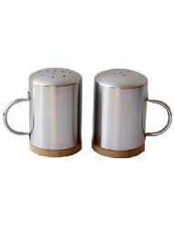


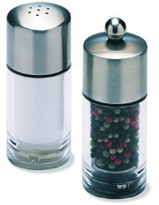

Slide 45
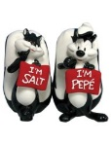

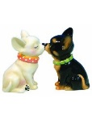

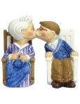
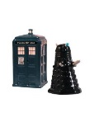
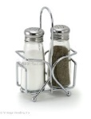

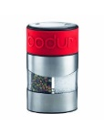
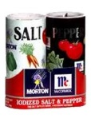
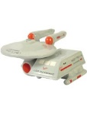
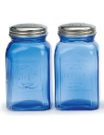

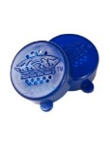
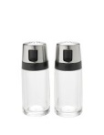

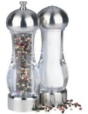

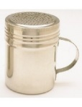


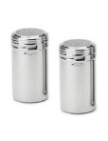
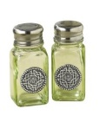
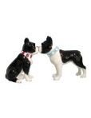



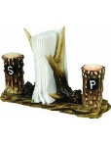
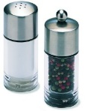


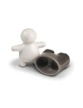
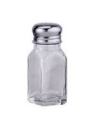
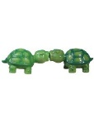
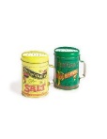
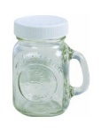

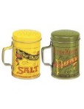
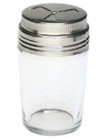
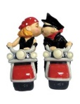



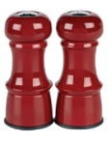

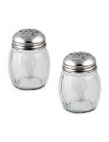
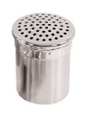
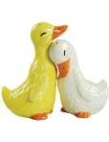
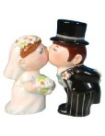
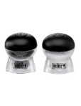
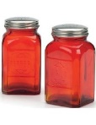
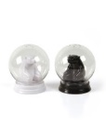
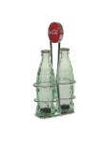





































45

Slide 46

















































































Slide 47














Slide 48


Slide 49
‡
Paid crowdsourcing is useful for personalization
‡ with nuances – this is where it gets interesting

Slide 50
DESIGNING TASKS FOR SUBJECTIVE NEEDS
Taste-Matching
Requester
$$sim(requester, worker)$$
Crowd Worker
50
Notes:
How do our approaches work? In the first…
Taste-matching
Things to note
Finding your taste-soul mate; building your turker army
Similar to on-demand collaborative filtering
You can borrow techniques from there, e.g. sim measures
Where it can change
Similarity metric
Choice of training items
Size of training set
Not worth mentioning in talk: (Recommendation method: do you take a single similar worker’s suggestion, or an aggregate)

Slide 51
DESIGNING TASKS FOR SUBJECTIVE NEEDS
Taste-Matching
Requester
Requester
Crowd Worker
Notes:
Why would you want on-demand personalization?
Good for collections with little existing data
Personal collections
E.g. personal photos, email
New corpora of data
E.g. the next Amazon, Netflix
Niche information
Where nobody would care enough to collect such preference data, nor would people care to volunteer it
Time-dependent opinions
When things change (e.g. food cravings, film desires), it’s difficult to collect information over an extended period of time

Slide 52
Requester
Requester
Requester
Requester

Slide 53

Notes:
Like the proverbial blind men beholding an elephant, each grokker has their own interpretation of the truth that is more effective in the bigger picture.
(No known copyright, http://www.loc.gov/pictures/item/2004666374/)

Slide 54














DESIGNING TASKS FOR SUBJECTIVE NEEDS
Task 1: Image Recommendation
Products
?
?
?
?
Food
?
?
?
?
54
Notes:
Why would you want on-demand personalization?
Good for collections with little existing data
Personal collections
E.g. personal photos, email
New corpora of data
E.g. the next Amazon, Netflix
Niche information
Where nobody would care enough to collect such preference data, nor would people care to volunteer it
Time-dependent opinions
When things change (e.g. food cravings, film desires), it’s difficult to collect information over an extended period of time

Slide 55
DESIGNING TASKS FOR SUBJECTIVE NEEDS
Results
Taste-Matching
Measured using root-mean-squared-error, to measure deviation of recommendation from ground truth of requester preferences
 | Products | Food Set #1 | Food Set #2
Baseline | 1.64 | 1.51 | 1.58
Best matched of five-workers | 1.43 (13%) | 1.19 (22%) | 1.26 (20%)
Best matched of ten workers | 1.35 (18%) | 1.08 (29%) | 1.08 (31%)
55
Notes:
The quality of the workers you find depends on how man you ask.
If you take the word of 1 person (the baseline)…
If you match against five people and use the opinion of the best…
Match against 10 people…
I’ll discuss this further later, but note that
Improvements on both sides, but
<click>
Food data was better improved by matching than product data
(why not aggregate taste-matching? This is possible; we were thinking of cases where you can accumulate ‘assistants’ that would look at different parts of the dataset for you)

Slide 56
DESIGNING TASKS FOR SUBJECTIVE NEEDS
Results
Taste-Grokking
 | Products | Food Set #1 | Food Set #2
Baseline | 1.64 | 1.51 | 1.58
Any grokker | 1.29 (21%) | 1.53 (1.3%) | 1.57 (0.5%)
5 rand grokkers | 1.07 (34%) | 1.38(9%) | 1.28 (19%)
5 good grokkers | 1.02 (34%) | 1.22 (19%) | 1.13 (28%)
56
Notes:
We found the inverse to be true for taste-grokking.
For taste-grokking, the salt-shakers are predicted much better.
For the food, if you ask anybody to guess, they’re not going to be that good; asking a few peope improves that recommendation.

Slide 57


DESIGNING TASKS FOR SUBJECTIVE NEEDS
Results
Personalization in this form was a good fit for crowdsourcing
Matching was better for food, grokking better for salt-shakers
Latent vs. Manifest decision factors: overfitting mental models
Increases in N are more fruitful for matching
57
Notes:
Matching was better for food, grokking better for salt-shakers
Why?
The factors of saltshaker decision making is more visible
When we tried clustering by taste, we saw more surprised in how food groups: overfitting mental models
In a complex space like food, you may need more profiling examples
If you can afford it, added people to matching keeps improving quality
In grokking, you only need a few people

Slide 58
DESIGNING TASKS FOR SUBJECTIVE NEEDS
Super-Grokkers
The best grokkers outperform the best-matched
 | Products | Food | Food
Baseline | 1.64 | 1.51 | 1.58
Taste-matching: Best 3 workers | 0.89 (46%) | 1.02 (32%) | 1.19 (25%)
Taste-grokking: Best 3 workers | 0.87 (47%) | 0.78 (48%) | 0.79 (50%)
58
Notes:
- The trick is identifying them beforehand, which is difficult to do

Slide 59
























Requester
Requester
Crowd Worker

Slide 60


Slide 61

DESIGNING TASKS FOR SUBJECTIVE NEEDS
Task 2: Text Summarization
Matching does work for a complex task like this
Grokkers fare poorly, but once again, we see super-grokkers
Potentially an appropriate task for written expression of needs, a la EmailValet (Kokkalis et al. 2013) and Mobi (Zhang et al 2012)
61
Notes:
- The trick is identifying them beforehand, which is difficult to do

Slide 62
DESIGNING TASKS FOR SUBJECTIVE NEEDS
Matching or Grokking?
Task Complexity
Are the factors affecting opinion-forming easy to communicate by example?


Quality Control
Data Reuse
Grokking is task-driven, with apparent ground truth – traditional quality control can be used.
Grokking is requester-specific; matching is useful for bootstrapping collaborative filtering and has higher ceiling

Satisfaction
Feedback suggests grokking seems more fun
62
Notes:
Grokking is task-driven, with apparent ground truth – traditional quality control can be used.
In matching, workers are asked to give their opinion, so it’s hard to tell if they are cheating; however, they’ll usually remain unmatched
Task complexity
Are the factors affecting opinion-forming easy to make sense of?
- Our workers spoke of their decision making for salt-shakers in predominantly visual terms

Slide 63
Takeaway
Crowdsourcing doesn’t have to be only objective or normative tasks! It is promising in domains where lack of prior data limits established personalization methods.
Taste-matching is good for personalizing complex tasks, and ongoing engagements with workers
Taste-grokking is great for quick-start tasks with manifest opinion factors, and for spicing up boring tasks

